Slide 1
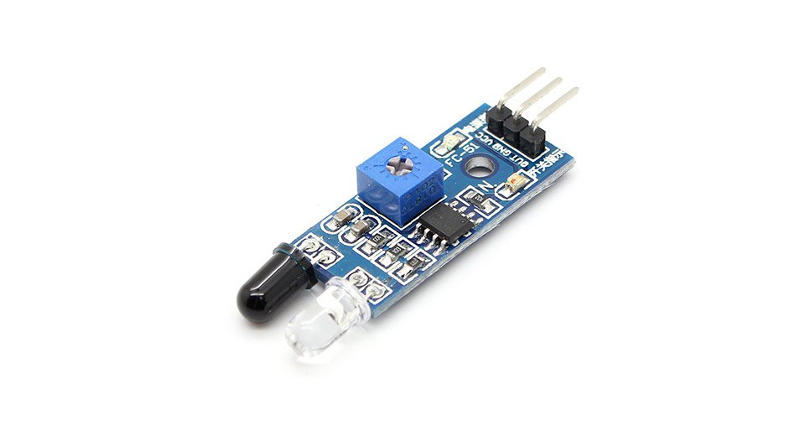
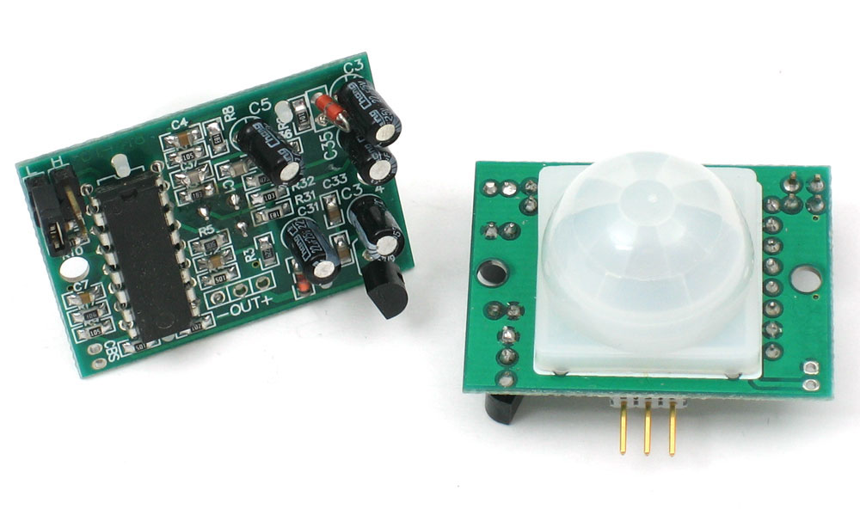


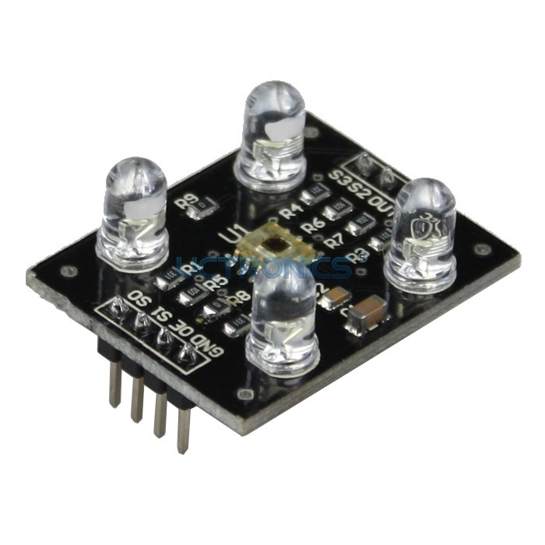
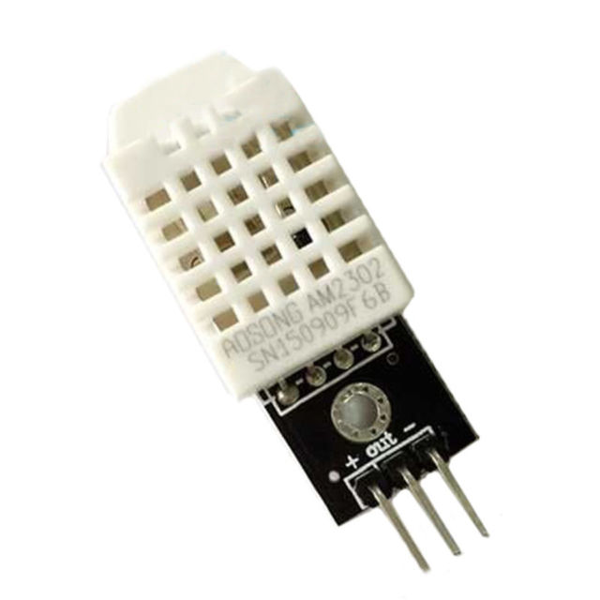
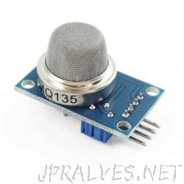
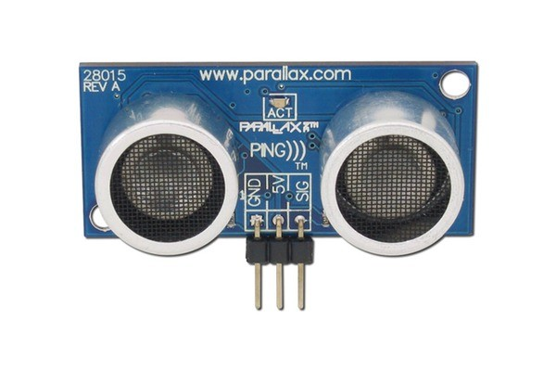
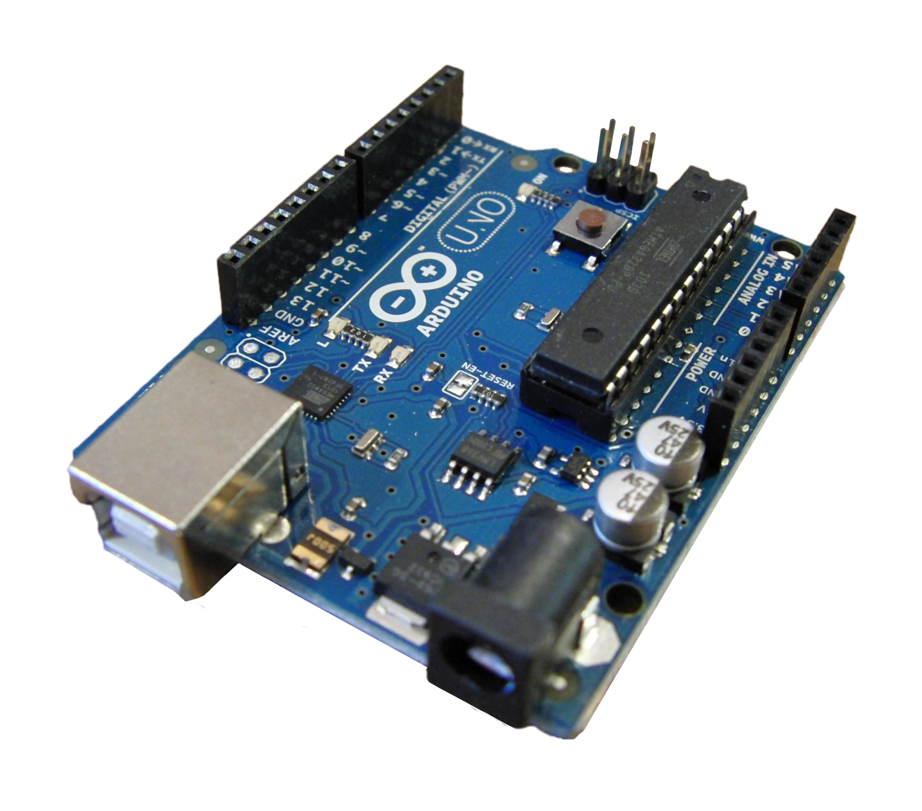
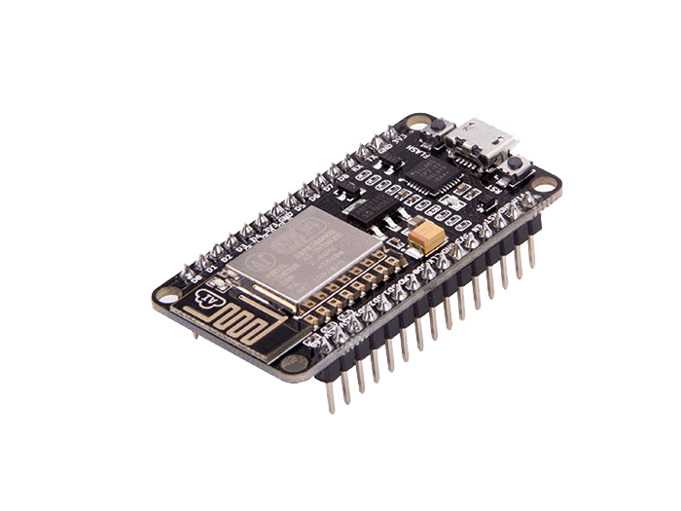
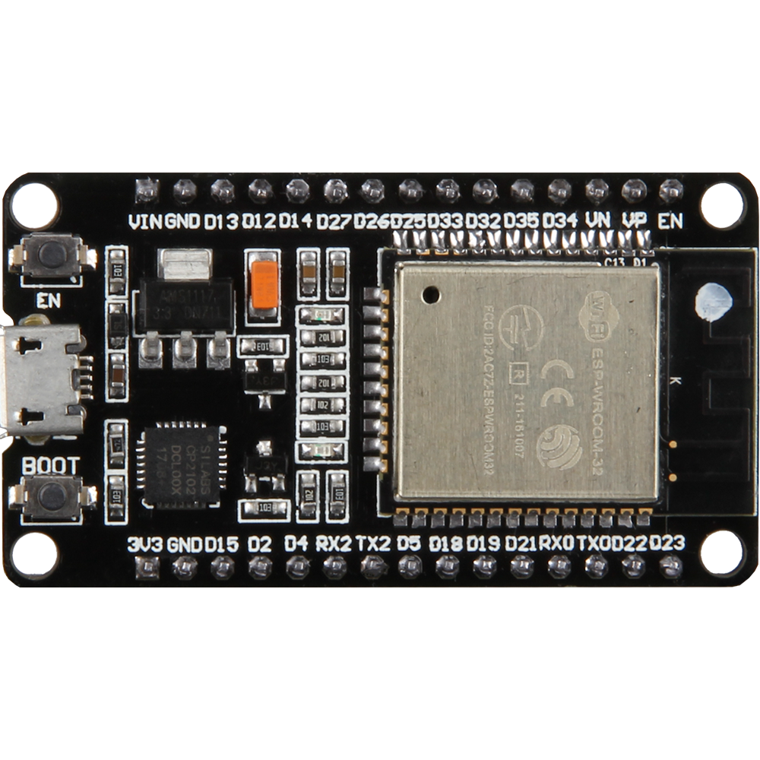
Arduino Step by Step Getting Serious And IoT
Name: JOYDIP DUTTA
Branch: Electronics And Communication Engineering
Semester: VII
Roll Number: 17EREEC006

Slide 2


Slide 3
Contents
Getting Familiar with Development Board
Visualization of the Sensors.
Software Installations
First talk with the Arduino.
Setting up Multiple Platform for IoT.
Play with Infrared Sensors
Let’s See Some Projects.

Slide 4
Getting Familier with Development Board
SECTION-1
Arduino UNO
NodeMCU ( ESP12E )
ESP32-WROOM-32D

Slide 5
GETTING FAMILIER WITH DEVELOPMENT BOARD
SECTION-1A
INTRODUCTION TO ARDUINO UNO
Open-source hardware platform
Affordable hardware
Easy to set-up for basic applications
Well established community support
Easily expandable functionality with on-top shields and GPIO available on-board
Arduino Uno, Arduino YUN (with Wi-Fi), Arduino MKR family (with Wi-Fi, BLE, LoRa, SigFox and Narrowband IoT)

Slide 6
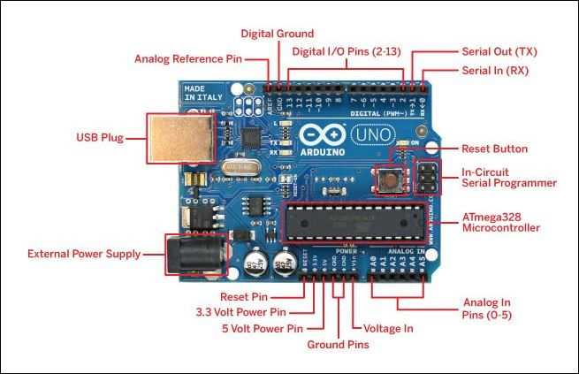
OVERVIEW OF ARDUINO UNO
SECTION-1A

Slide 7
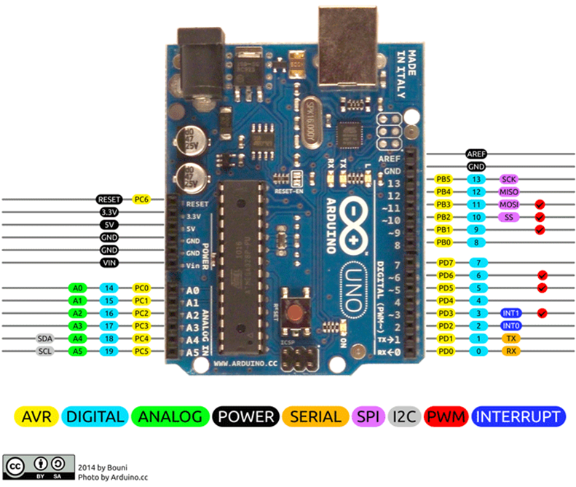
PIN CONFIGURATIONS OF ARDUINO UNO
SECTION-1A

Slide 8
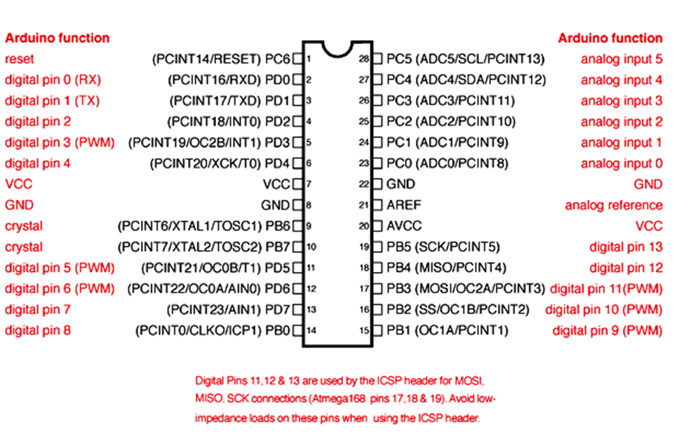
MIND OF THE ARDUINO ( ATMEGA328P)
SECTION-1A

Slide 9
GETTING FAMILIER WITH DEVELOPMENT BOARD
SECTION-1B
INTRODUCTION TO NodeMCU
Also known as ESP8266 development board.
Affordable hardware for IoT Projects.
Easy to set-up for basic applications
Well established community support
NodeMCU is an open-source LUA based firmware developed for the ESP8266 WiFi chip.
Espressif System (A Shanghai-based Semiconductor Company) has released this adorable, bite-sized WiFi-enabled microcontroller - ESP8266 chip.

Slide 10
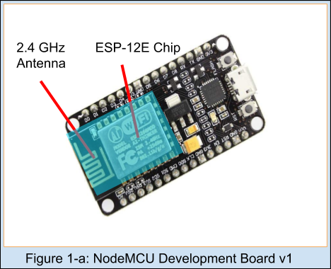
OVERVIEW OF NODEMCU
SECTION-1B
ESP-12E WiFi Module
This ESP-12E module containing an ESP8266 chip having Tensilica Xtensa® 32-bit LX106 RISC microprocessor which operates at 80 to 160 MHz adjustable clock frequency and supports RTOS.
There’s also 128 KB RAM and 4MB of Flash Memory is available which is enough to cope with large strings that make up web pages, JSON/XML data, and everything we use in IoT devices nowadays.
The most versatile feature of NodeMCU is that it can set up a network of its own which allows the other devices to connect directly to it. This is possible because ESP8266 integrates 802.11b/g/n HT40 Wi-Fi transceiver.
This module has 2.4 GHz Antenna which is enough to give us a proper range for our projects.

Slide 11
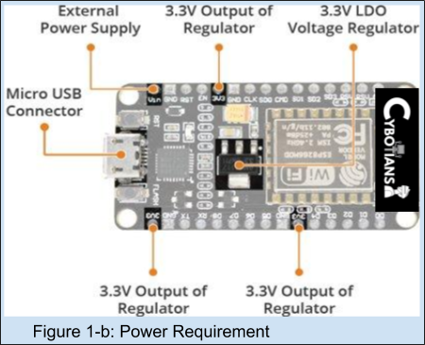
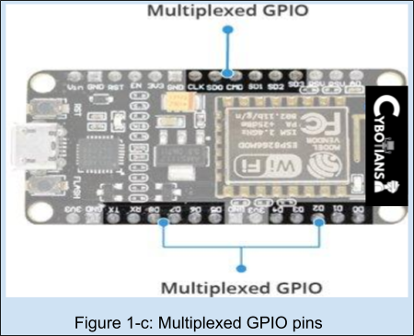
OVERVIEW OF NODEMCU CONTINUES
SECTION-1B
Power Requirements
Operating Voltage: 2.5V to 3.6V
On-board regulator: 3.3V 600mA regulator
Operating Current: 80mA
Current during Sleep Mode: 20 µA
Peripherals & Input/Output
Total GPIO pins: 17
ADC channel: A 10-bit ADC channel
UART interface: UART interface is used to load code serially.
PWM outputs: PWM pins for dimming LEDs or controlling motors.
SPI & I2C: SPI and I2C interface to hook up all sorts of sensors and peripherals.
I2S Interface: I2S interface if you want to add sound to any project.
Multiplexing Feature: A single GPIO pin can act as PWM/UART/SPI.

Slide 12
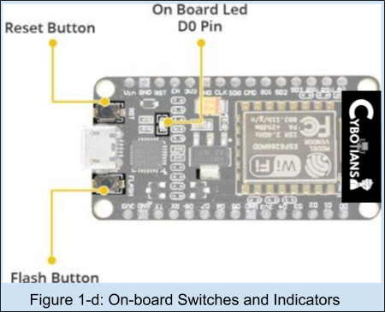
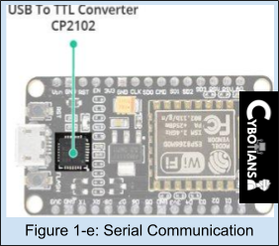
OVERVIEW OF NODEMCU CONTINUES
SECTION-1B
On Board Switches & LEDs
RST Button: Reset the ESP8266 chip
FLASH Button: Download new programs
Blue LED: Work as an Indicator. (User Programmable)
Serial Communication
CP2102 USB-to-UART converter: It is a bridge converter which converts USB signal to Serial. This allows our computer to program and communicate with the ESP8266 chip.
Communication Speed: 4.5Mbps.

Slide 13
PIN DESCRIPTION OF NODEMCU BOARD
SECTION-1B
Pins (according to functionality) | Availability | Description
Power Pins | One Vin pin, three 3.3V Pins(Vout), and Five ground Pins are available. | Vin Pin: Used to provide power supply to the board directly. 3.3V Pin: Used to supply power to external components.
I2C Pins | D1 and D2 pin are available as an SCL and SDA pin respectively. | D1 and D2 are used to hook up all sorts of I2C Sensors.
GPIO Pins | There are 17 pins are available as GPIO. | These pins can be assigned to various functions programmatically.
ADC Channel | VDD3P3 pin and TOUT pin. | Used as an ADC pin but cannot be implemented at the same time.
UART Pins | UART0 ( TXD0, RXD0, RST0, and CTS0 Pins ) UART1 ( TXD1 Pin) | UART0: can be used for communication and it supports fluid control. UART1: It features only the data transmit signal.

Slide 14
PIN DESCRIPTION OF NODEMCU BOARD CONTINUES
SECTION-1B
Pins (according to functionality) | Availability | Description
SPI Pins | SPI and HSPI Pins. | Supports 4 timing modes of the SPI format transfer.
PWM Pins | Four Channels of PWM. | PWM can be implemented programmatically. The frequency range is adjustable from 1000 μs to 10000 μs, i.e., between 100Hz and 1 kHz.
Control Pins | Enable Pin(EN), Reset Pin(RST) & WAKE pin. | EN pin: Control the ESP8266 chip by set it as a HIGH and LOW. RST pin: Used to Reset the ESP8266 chip. WAKE pin: Used to wake the chip from a deep-sleep mode.
SPI Pins | SPI and HSPI Pins. | Supports 4 timing modes of the SPI format transfer.

Slide 15
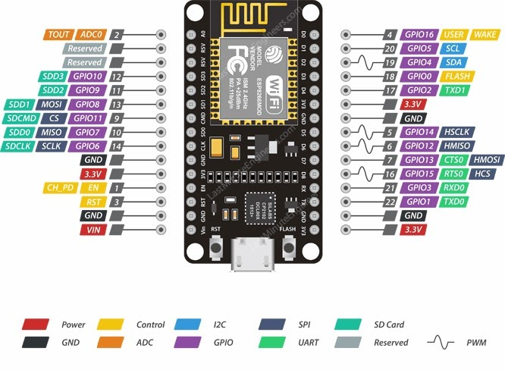
PIN DESCRIPTION OF NODEMCU BOARD CONTINUES
SECTION-1B
https://cybotians.com
https://cybotians.com
https://cybotians.com

Slide 16
GETTING FAMILIER WITH DEVELOPMENT BOARD
SECTION-1C
INTRODUCTION TO ESP32
ESP32 is a series of low cost, low power system on chip microcontrollers with integrated Wi-Fi & dual-mode Bluetooth.
Easy to set-up for basic applications
Well established community support
ESP32 is created and developed by Espressif Systems, a Shanghai-based Chinese company

Slide 17
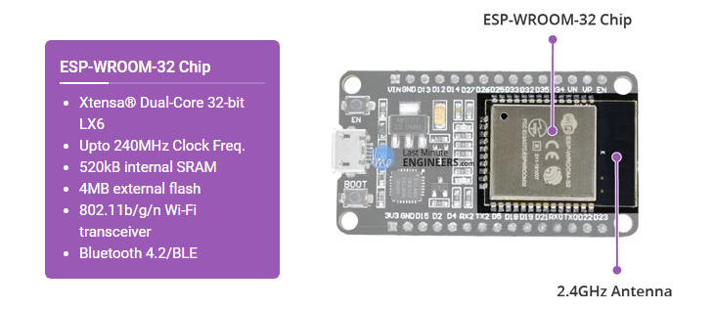

OVERVIEW OF ESP32
SECTION-1C

Slide 18
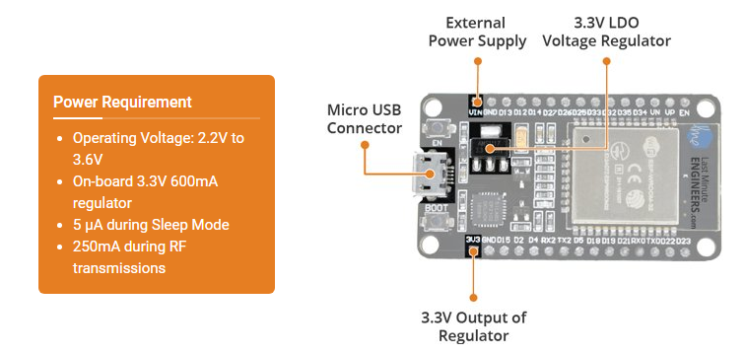
OVERVIEW OF ESP32
SECTION-1C

Slide 19
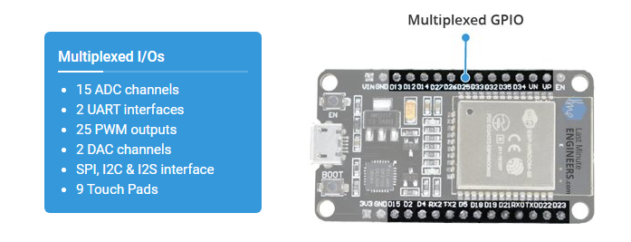
OVERVIEW OF ESP32
SECTION-1C

Slide 20
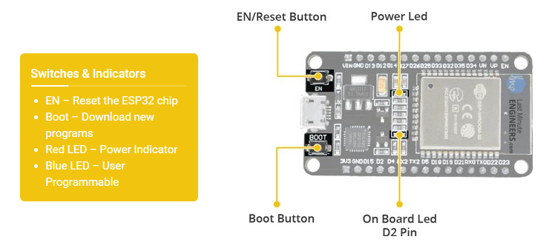
OVERVIEW OF ESP32
SECTION-1C

Slide 21
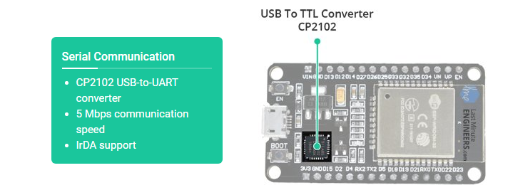
OVERVIEW OF ESP32
SECTION-1C

Slide 22
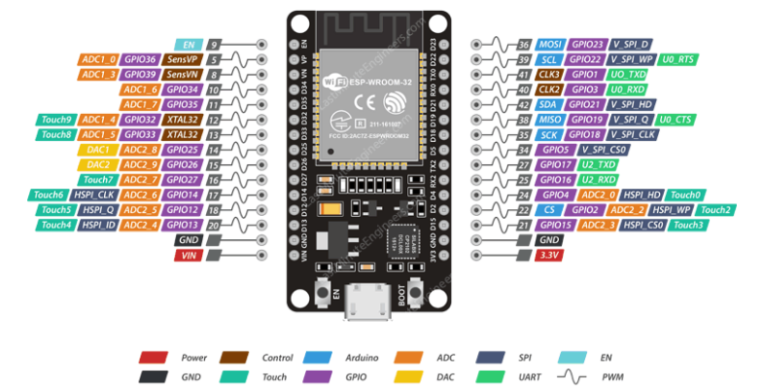
PIN DESCRIPTION OF ESP32-WROOM-32
SECTION-1C
https://cybotians.com
https://cybotians.com
https://cybotians.com

Slide 23
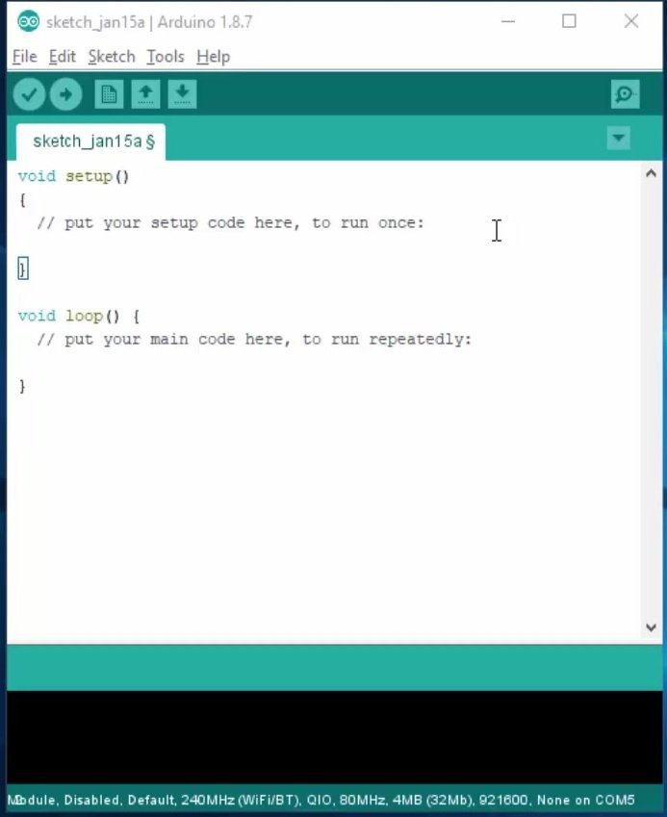

SOFTWARE INSTALLATIONS
SECTION-2
Arduino IDE
Android Studio

Slide 24
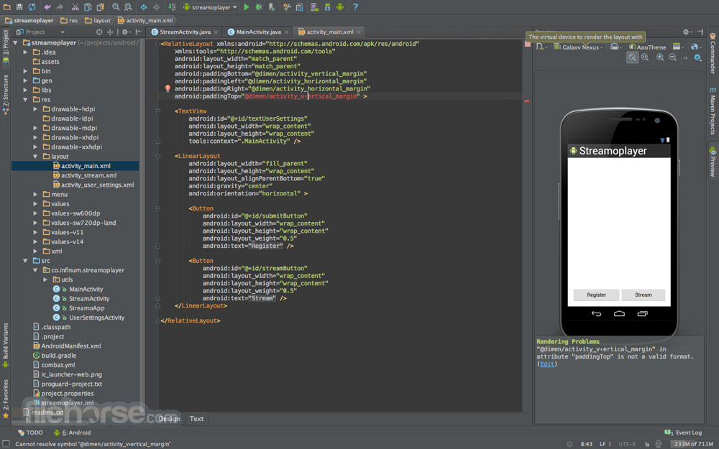
SOFTWARE INSTALLATIONS
SECTION-2
Arduino IDE
Android Studio

Slide 25
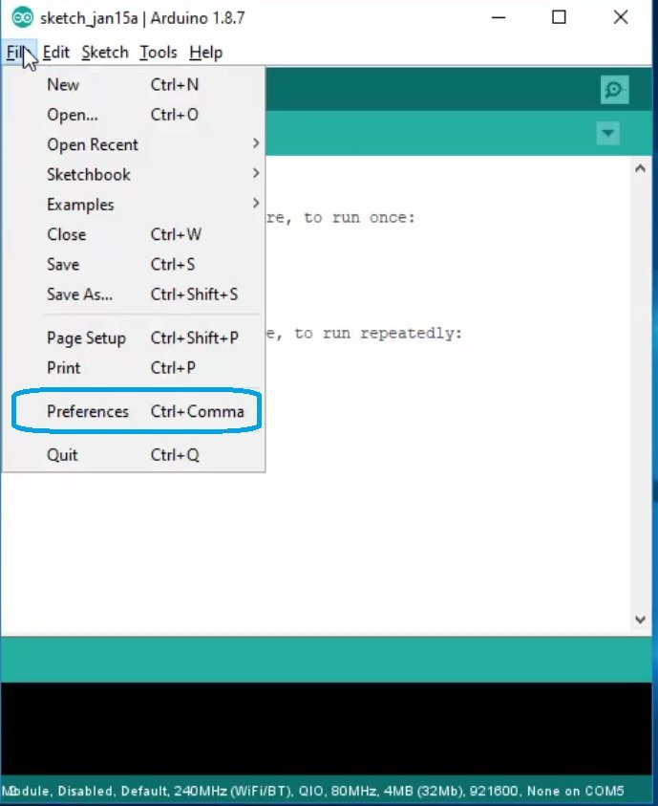
SOFTWARE INSTALLATIONS CONTINUES
SECTION-2A

Slide 26
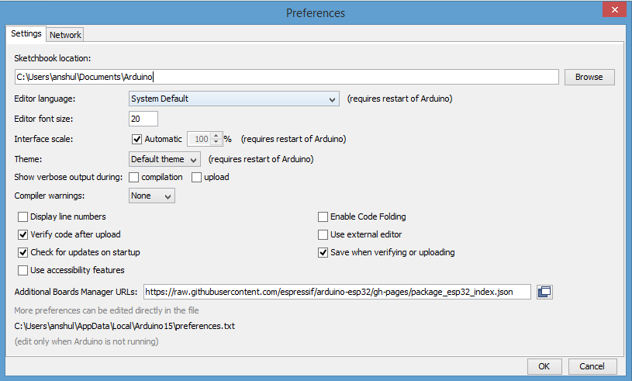
SOFTWARE INSTALLATIONS CONTINUES
SECTION-2A
http://arduino.esp8266.com/stable/package_esp8266com_index.json ,
https://raw.githubusercontent.com/espressif/arduino-esp32/gh-pages/package_esp32_index.json

Slide 27



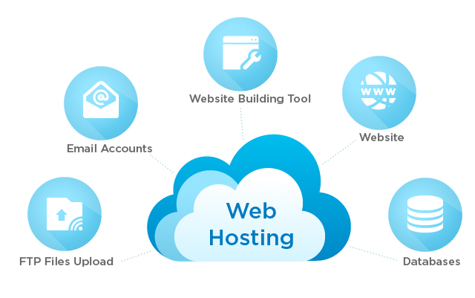


Setting up Multiple Platform for IoT
SECTION-4
Tinkercad
Adafruit IO
IFTTT
Google Firebase
MIT App Inventor
WebBrowser and MySQL

Slide 28
Setting up Multiple Platform for IoT Continue
Adafruit IO & IFTTT
Sensors
Website
( Using 000webhosts for free hosting )
MySQL Database
Actuators
Development boards
[ ESP8266 & ESP32 ]
User
Android App
( 1. Android Studio
2. MIT APP Inventor)
FireBase Database
Displays

Slide 29
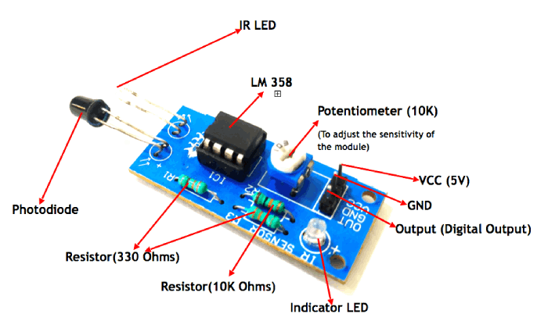
IR Sensor Module

Slide 30
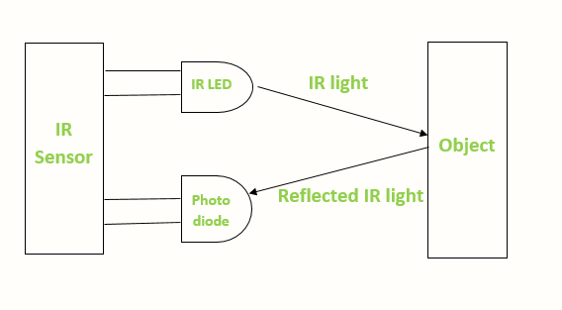
IR Sensor Module Continues
WORKING OF IR SENSOR MODULE

Slide 31
IR Sensor with ESP8266 and Firebase
Firebase Database
ESP8266
IR SENSOR

Slide 32
Let’s See Some Demo

